Slide 1
Secure Software Development Process

Slide 2
Software Development Lifecycle (SDLC)
Requirement
Design
Implementation
Testing
Deployment
Maintenance

Slide 3
Secure Software Development Process (continued)
A secure software development process includes three main ingredients:
SDLC in the industry
SDLC in the organization
SDLC in the cube

Slide 4
SDLC in the Industry
Standard development life cycle—IEEE 12207
The ISO/IEEE 12207 standard provides the industry with standard activities each software project must follow to be compliant
The ISO/IEEE 12207 can be looked at as the standard of all standards
System requirements analysis
System design
Software architectural design
Software detailed design
Software coding
Software testing
Software installation
Software acceptance
Software maintenance
→ Define system requirements
→ System Design
→ System Development
→ System Testing
→ System Deployment
→ System Maintenance

Slide 5
SDLC in the Organization
A software methodology is a set of methods, procedures, and rules that can be repeatedly carried out to produce software
To list a few:
Waterfall
Iterative
Spiral
Agile

Slide 6
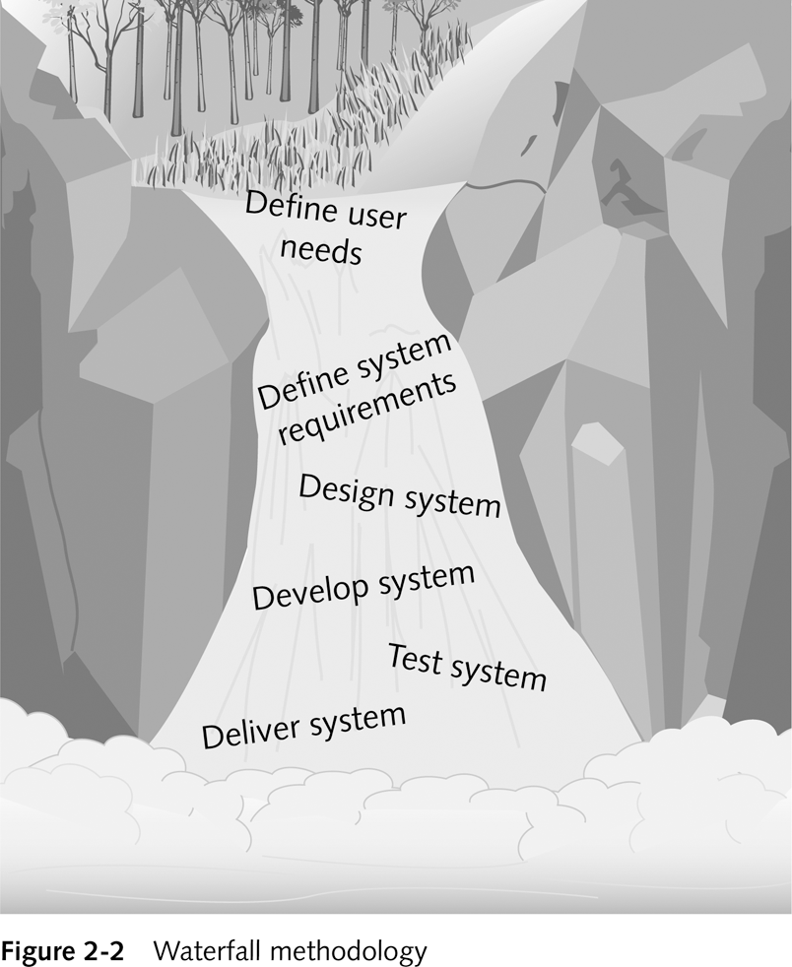
SDLC in the Organization (continued)
Waterfall
It is best suited when the size and scope of the project is small and generally well understood by all team members on the development team.
This methodology is too restrictive and forces the developers to complete each phase before moving on
It is also very rare that the users know exactly what they want
Poor communication and false assumptions are prevalent in this approach

Slide 7
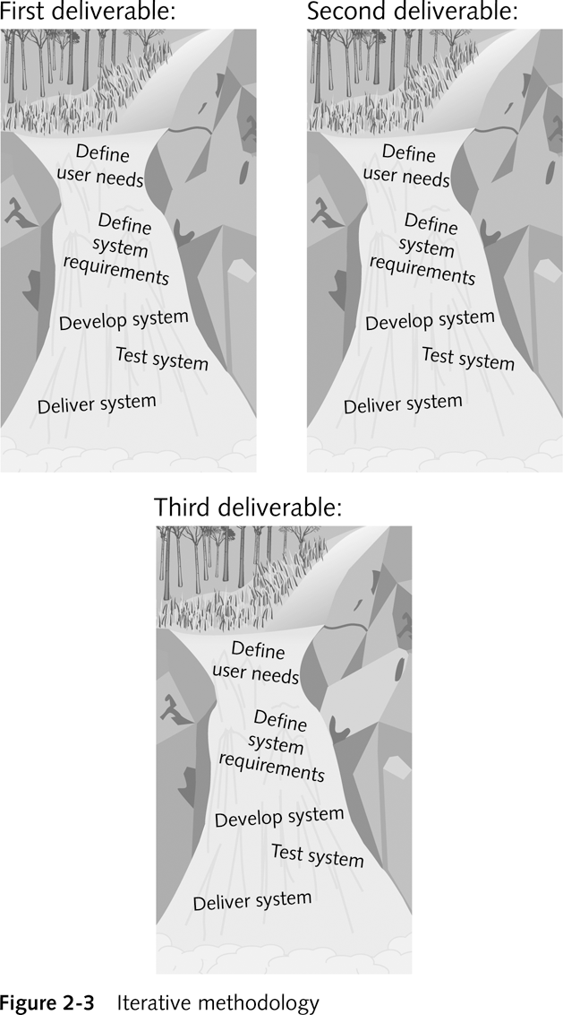
SDLC in the Organization (continued)
Iterative
Great for moderate to large applications with varying degrees of complexity
The iterative process tends to be too constrictive for teams that have been working together closely for years
Because the iterative process really concentrates on one feature at a time, some mature teams do not like the pace
End users and customers cannot afford to spend the amount of time needed to test each new feature as it’s launched

Slide 8
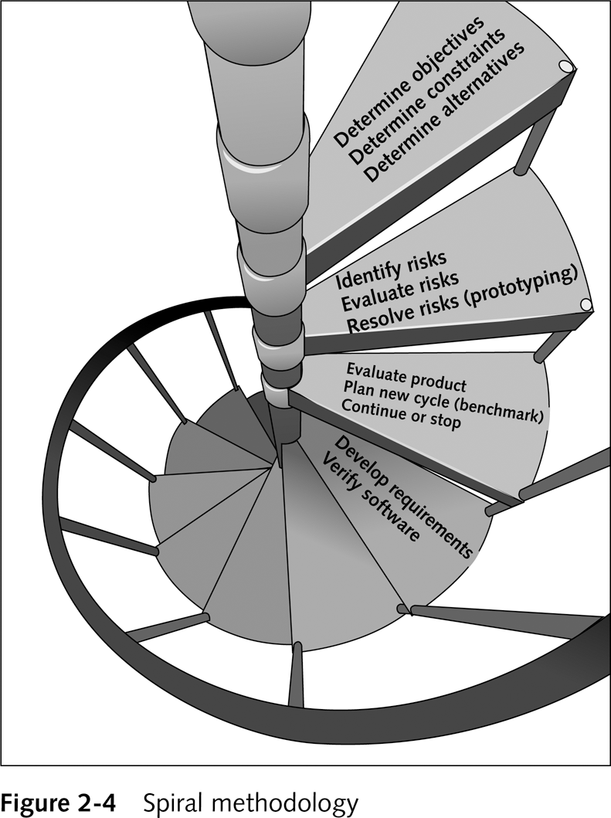
SDLC in the Organization (continued)
Spiral
This spiral process allows developers and
users to analyze each requirement and
apply appropriate what-if questions
It takes a lot of development time
to produce and analyze prototypes
End users and customers cannot afford
to spend the amount of time needed
to test each new feature as it’s launched

Slide 9
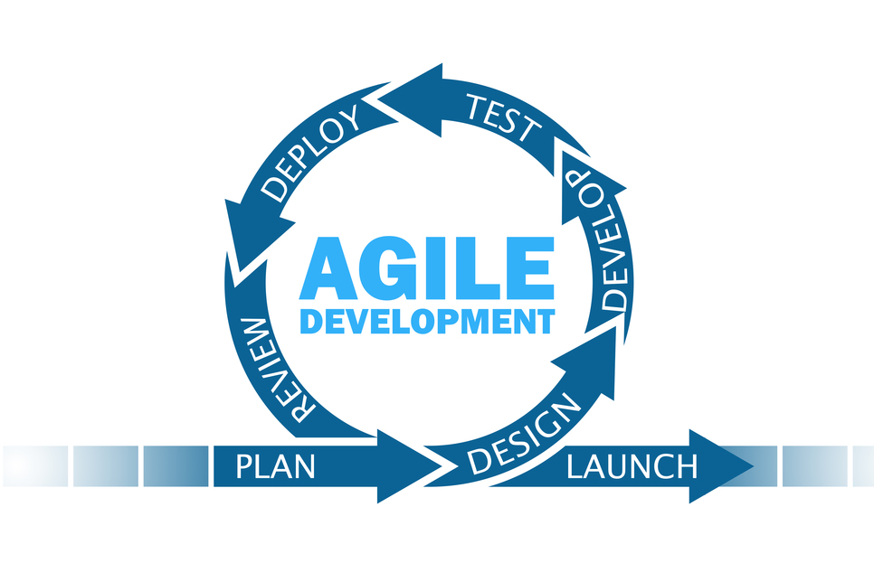
SDLC in the Organization (continued)
Advanced Methodologies
Agile development
is a project management framework that breaks projects down into several dynamic phases, commonly known as sprints.

Slide 10
SDLC in the Cube
Define the roles and responsibilities for the team
Communicating effectively
Encouraging discussions

Slide 11
The Development Team (continued)
Makeup of a Development Team
1. Project manager (PM)
This person has strong management skills and is keenly aware of the SDLC
He or she is likely a PMP (project management professional) certified to manage an IT project
The PM is fully aware of the security needs and policies of the current project
2. Business analyst (BA)
A business analyst is someone who knows and understands the business side of the application
This person takes customer requests and translates them into software requirements

Slide 12
The Development Team (continued)
Makeup of a Development Team (continued)
3. Tech lead (lead developer)
This person is very efficient in the technology used on the project
Aware of the security needs of the application
Required to know secure design principles and methodologies and how to apply threat modeling and threat analysis
4. Developers
A developer is responsible for designing and building the software system
Has a deep understanding of system requirements and architecture
Implements functionality using appropriate programming languages and tools
Writes clean, efficient, and maintainable code
Collaborates with testers and other team members to ensure software quality

Slide 13
The Development Team (continued)
Makeup of a Development Team (continued)
4. Testers
A tester is someone with a thorough understanding of the system’s requirements
Knows how the system was designed and developed
Knows how to break software
5. Customer/user
An end user is someone with a thorough understanding of the system’s requirements
Knows how the software will be used by the masses

Slide 14
Principles of Security

Slide 15
Principles of Security in the Industry
Principles are the foundation of software applications and the development processes that produce them
These principles are industry best practices
Developers must learn how to incorporate these principles into the development process
Know the goals of secure code
Know the goals of quality code

Slide 16
Principles of Security and Quality in the Industry (continued)
Goals of Secure Code
- Secure software means keeping C.I.A.
Confidentiality: Attained by keeping unauthorized users (humans or software) from accessing confidential information
Integrity: The way in which the application accepts, transmits, and stores data from the point of entry all the way to the database and back
Availability: System is available during its normally scheduled hours of operation

Slide 17
Principles of Security in the Industry (continued)
Goals of Secure Code (continued)
Authorization and authentication are the two properties that support secure code
Authorization: Ensuring that the user has the appropriate role and privilege to view data
Authentication: Ensuring that the user is who he or she claims to be and that the data comes from the appropriate place

Slide 18
Principles of Security in the organization
Each company has its own view(s) of what the goals of C.I.A.
How organizations achieve C.I.A. depends on the resources, time, and assets that are available to the company
Companies can achieve C.I.A. by implementing security and quality principles

Slide 19
Principles of Security in the organization (continued)
The Principles and Concepts of Secure Software
Attack Surface Reduction
Attack Surface: Any part of an application that is accessible by a human or another program
Attack Surface Reduction: Minimize the number of exposed attack surface points a malicious user can discover and attempt to exploit

Slide 20




Principles of Security in the organization (continued)
Attack Surface Reduction

Slide 21
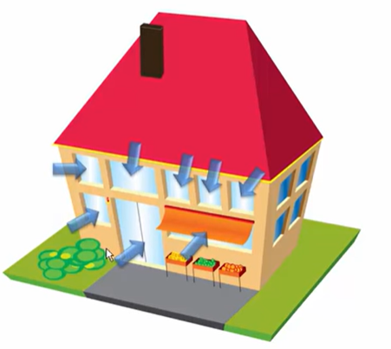
Principles of Security in the organization (continued)
Attack Surface Reduction

Slide 22

Principles of Security in the organization (continued)
Attack Surface Reduction

Slide 23
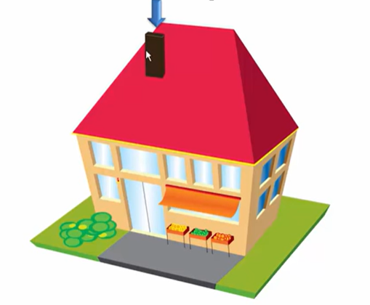
Principles of Security in the organization (continued)
Attack Surface Reduction

Slide 24
Principles of Security in the organization (continued)
The Principles and Concepts of Secure Software
Secure the Weakest Link
The weakest part of the system will most likely be attacked first
Analyzing and evaluating the weakest application layers and defensive layers is a principle that needs to be practiced at the beginning stages of software development (requirements) all the way through the maintenance stage

Slide 25
Principles of Security in the organization (continued)
The Principles and Concepts of Secure Software
Defense in Depth
Defense in depth is designed on the principle that multiple layers of different types of protection provide substantially better protection
The goal is to limit access to certain features of the application
Multiple layers of Defense

Slide 26
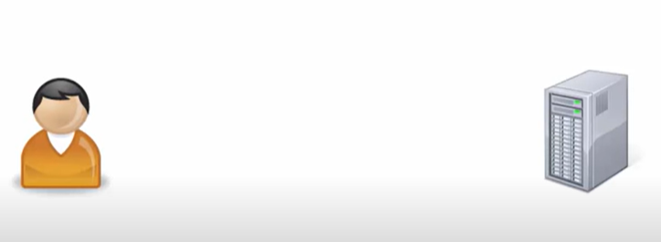
Principles of Security in the organization (continued)
Defense in Depth (continued)

Slide 27
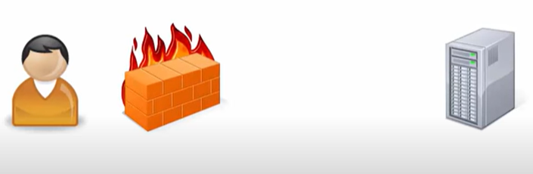
Principles of Security in the organization (continued)
Defense in Depth (continued)

Slide 28
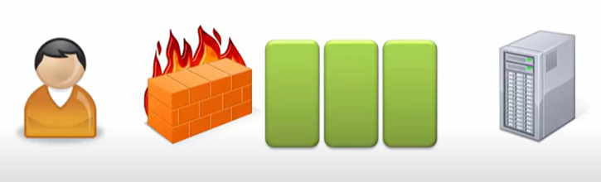
Principles of Security in the organization (continued)
Defense in Depth (continued)

Slide 29
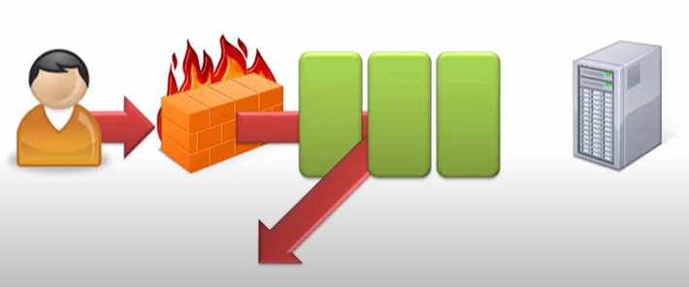
Principles of Security in the organization (continued)
Defense in Depth (continued)

Slide 30
Principles of Security in the organization (continued)
The Principles and Concepts of Secure Software (continued)
Fail Securely
Fail securely is simply what happens when the system goes down
Power failure, server crashes, and other network problems are reasons beyond the control of the application programmers
Address error-handling issues appropriately
Degrade gracefully

Slide 31
Principles of Security in the organization (continued)
The Principles and Concepts of Secure Software
Least Privilege
Give users the least amount of privilege required to perform the use case functionality
Applications that need access to other system resources; grant only what is needed

Slide 32

Principles of Security in the organization (continued)
Least Privilege

Slide 33
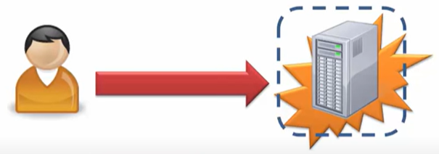
Principles of Security in the organization (continued)
Least Privilege
Admin/ System Level
----------------------------
read user files
Change system passwords
Download malicious files
Anything else

Slide 34
Principles of Security in the organization (continued)
Least Privilege
Admin/ System Level
----------------------------
read user files
Change system passwords
Download malicious files
Anything else
Normal user
----------------------------
read user files
Change system passwords
Download malicious files
Limited capabilities

Slide 35
Principles of Security in the organization (continued)
The Principles and Concepts of Secure Software (continued)
Keep It Simple
Keep security simple and keep the application simple
Keep the design simple
Keep the database and code as simple as possible
Do not try to win the award for most impressive or coolest code

Slide 36
Principles of Security in the organization (continued)
The Principles and Concepts of Secure Software (continued)
Secrets Are Not Kept
Application cannot secretly hide data from the user
People cannot secretly hide data from the user
Binary code is not secure code
Do not place hard-coded values in code

Slide 37
Principles of Security in the organization (continued)
The Principles and Concepts of Secure Software (continued)
The Saltzer and Schroeder Principles
Fail-safe defaults: Base access decisions on permission rather than exclusion.
Complete mediation: requires that all accesses to objects be checked to ensure they are allowed.
Open design: The design should not be secret.

Slide 38
Principles of Quality

Slide 39
Principles of Quality in the Industry (continued)
Goals of Quality Code
Total automation
Manage complexity
Software diversity

Slide 40
Principles of Quality in the Industry (continued)
Goals of Quality Code (continued)
Total automation
There are just two techniques used for software development: manual and automated
Manual techniques are the human ability to logically break down complex problems into smaller ones
Total automation is a tool-intensive process

Slide 41
Principles of Quality in the Industry (continued)
Goals of Quality Code (continued)
Complexity will always be a factor that developers must manage
Three ways to manage complexity:
Removal of complexity: Some requirements are just add-ons that are really not needed
Automation of complexity: Automate what is needed
Localization of complexity: Place logic on one spot (refactoring)

Slide 42
Principles of Quality in the Industry (continued)
Goals of Quality Code (continued)
Software Diversity
Software diversity is the ability to anticipate change in the software
Use CONSTANTS throughout all source code
Do not embed business logic with presentation
Design the application to be driven by parameters

Slide 43
Principles of Quality in the Industry (continued)
Create an application that reads two values from the user and print the addition of these values. Your application should implements an add function.

Slide 44
Principles of Security and Quality in the Organization (continued)
Principles and Concepts of Quality Software (continued)
Understandability
Are variables given meaningful names?
Do the names of the variables represent the actual value that they represent?
Are the logic and loops coded in a way where you can easily understand the programmer’s intent?
If a person did not understand the programming language, would the logic still be easy to read and follow?

Slide 45
Principles of Security and Quality in the Organization (continued)
Principles and Concepts of Quality Software (continued)
Portability
is said to be portable if there is very low effort required to make it run on different platforms.

Slide 46
Principles of Security and Quality in the Organization (continued)
Principles and Concepts of Quality Software (continued)
Maintainability
refers to the ease with which you can repair, improve and understand software code.
Testability
is a metric that defines how easily, effectively, and efficiently an application can be tested by QA teams

Slide 47
Principles of Security and Quality in the Organization (continued)
Principles and Concepts of Quality Software (continued)
Flexibility and Reusability
Can the code be modified easily without affecting a lot of modules and programs?
Can the code be reused for other purposes or services?
Is there a good separation of logic where reusable methods are not embedded with surrounding methods that are not reusable?

Slide 48
Principles of Security and Quality in the Organization (continued)
Principles and Concepts of Quality Software (continued)
Readability
If I were to print the method, would I be reading a short book?
Is the code base so big that a person gets lost trying to follow the execution path?

Slide 49
Principles of Security and Quality in the Organization (continued)
Principles and Concepts of Quality Software (continued)
Usability
Is a user manual provided?
Are meaningful error messages provided?

Slide 50
Principles of Security and Quality in the Organization (continued)
Principles and Concepts of Quality Software (continued)
Reliability
Can it handle concurrent users?
Is exception handling provided?

Slide 51
Applying Principles of Security and Quality in the Cube
They say in life that character is what a person does when he is alone; for developers, it is how you code programs when no one is watching over your shoulder
If your determination in this field is to produce great software and to become the best developer you can possibly be, your everyday decision making needs to be based on the beliefs that quality and security come first

Slide 52
Applying Principles of Security and Quality in the Cube (continued)
Security and quality code have to be a part of who the developer is
You cannot go back into the code after the software is produced and add these characteristics later
These characteristics take time and practice to sink in; but, like many sports, learning the right approach is the first step
In time, coding secure, efficient code will not only come natural, you wouldn’t want to do it any other way

Slide 53
Applying Principles of Security and Quality in the Cube (continued)
Quality Is an Art Form
Like art, software quality can mean many things to many people
End user might view software quality from a perspective of usability
Project managers might view as time and money
Technical operation may view as CPU efficiency, network traffic, and memory leaks

Slide 54
Applying Principles of Security and Quality in the Cube (continued)
Build Smart Applications to Back up Your Assurance Case
Log all activity
Keep track of failed attempts per user
Reset passwords regularly
Have tight password policies
Two-tier authentication

